Slide 1
Appointment Scheduling App
Pi App Studio Inc

Slide 2
Basic Features/Scope
Authentication
Phone Number OTP validation
Profile details
Dashboard
Gift Offer
Upcoming appointments
Feature Services
Appointment Booking
View Appointments
Schedule Appointments
Services
List of offered services
Service details with images, description and amount
Settings
Address, contact number, email, app details & privacy policy
Login/Logout option

Slide 3
Target Devices
Only Android platform
Android 7.0 (Nougat) – API 24 & Above
Portrait mode only
No additional permission is required (Internet is default)

Slide 4
Backend Configurations
Google Firebase (Spark Plan)
OTP Authentication (10k/Month free)
User maintenance
Appointment maintenance
Firebase backend tool for admin control
GitHub (up to GB)
Service list maintenance
Images/Videos maintenance

Slide 5
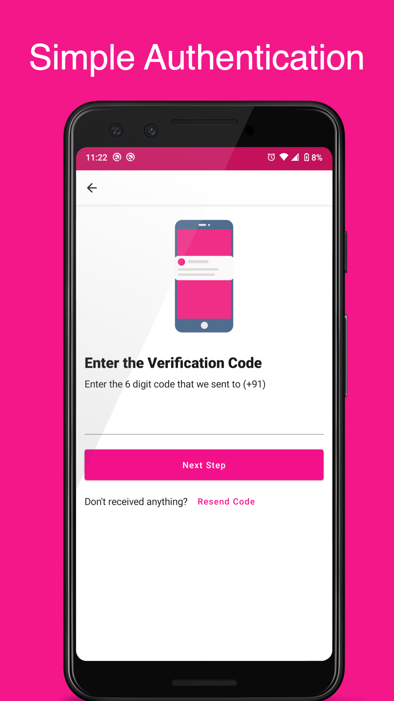
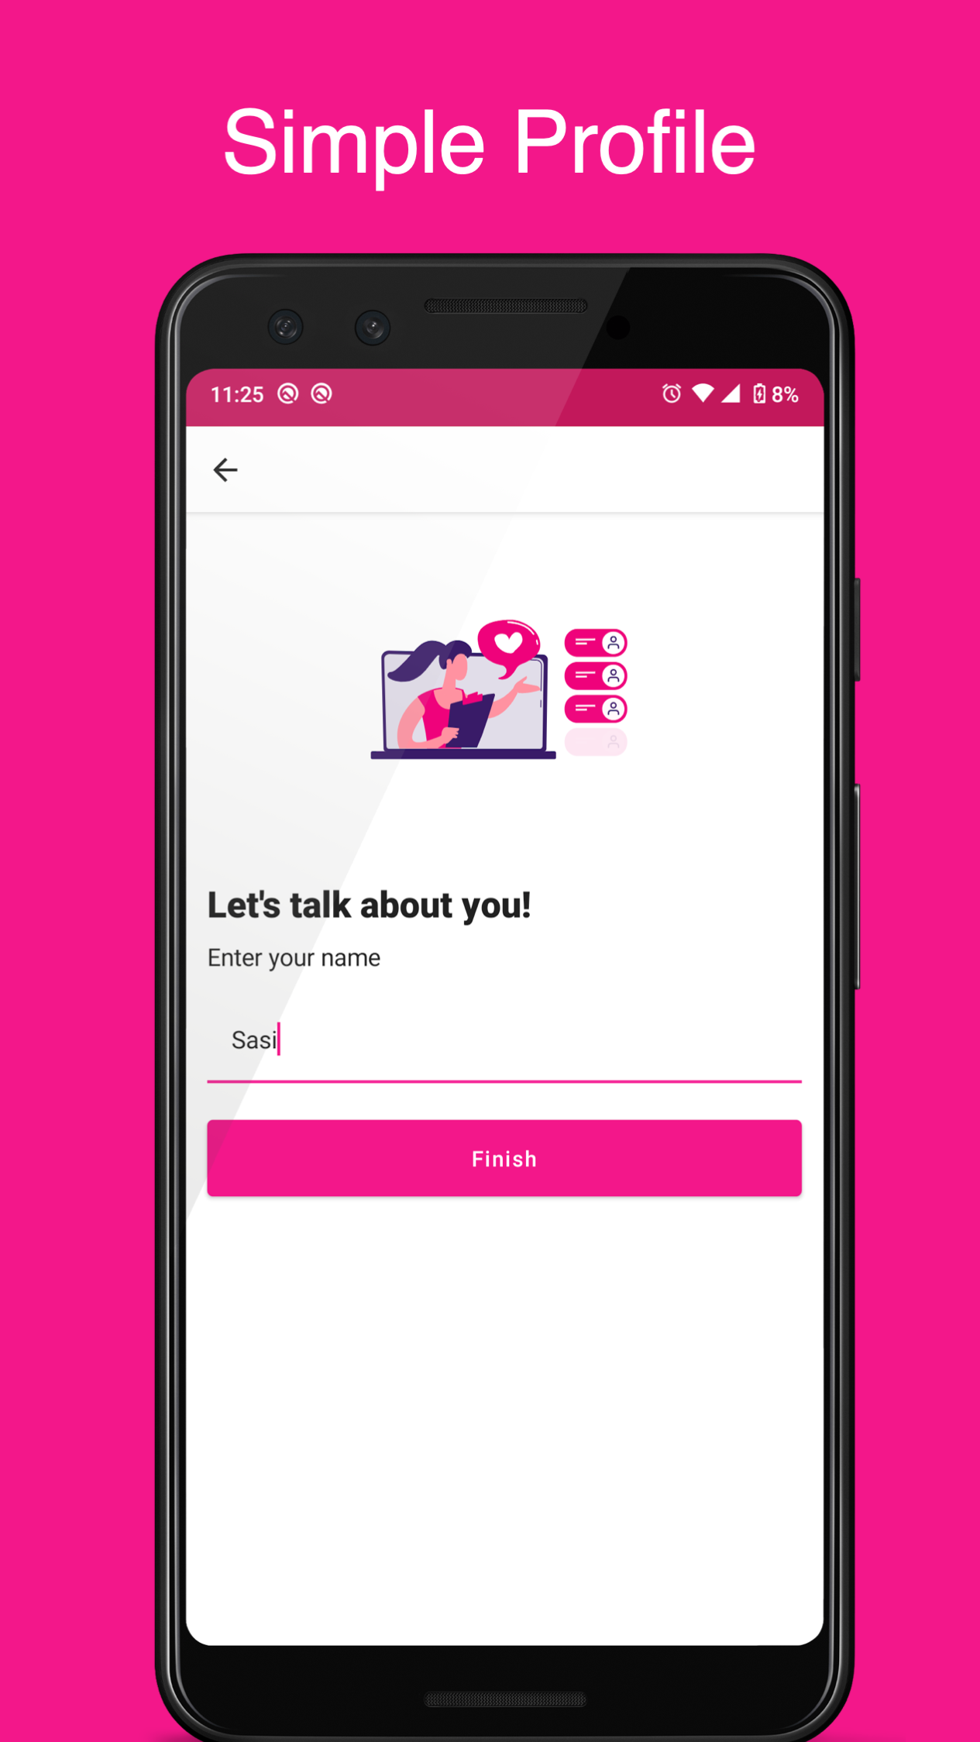
OTP Authentication

Slide 6
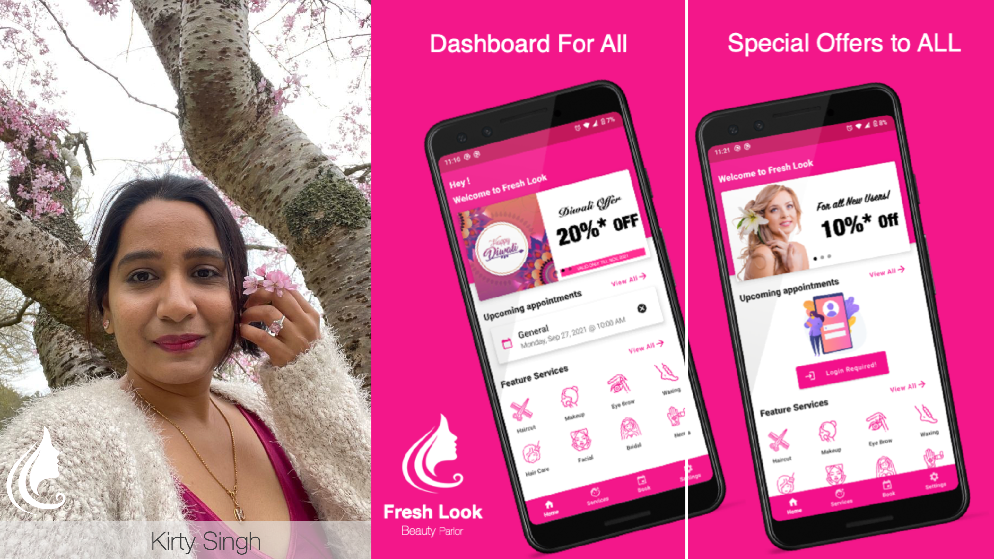
Dashboard
Dashboard

Slide 7
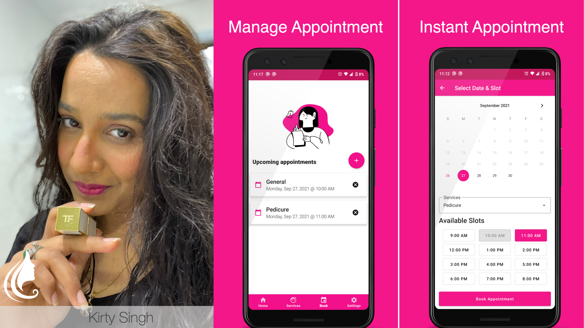
Manage Appointments
Manage Appointments

Slide 8
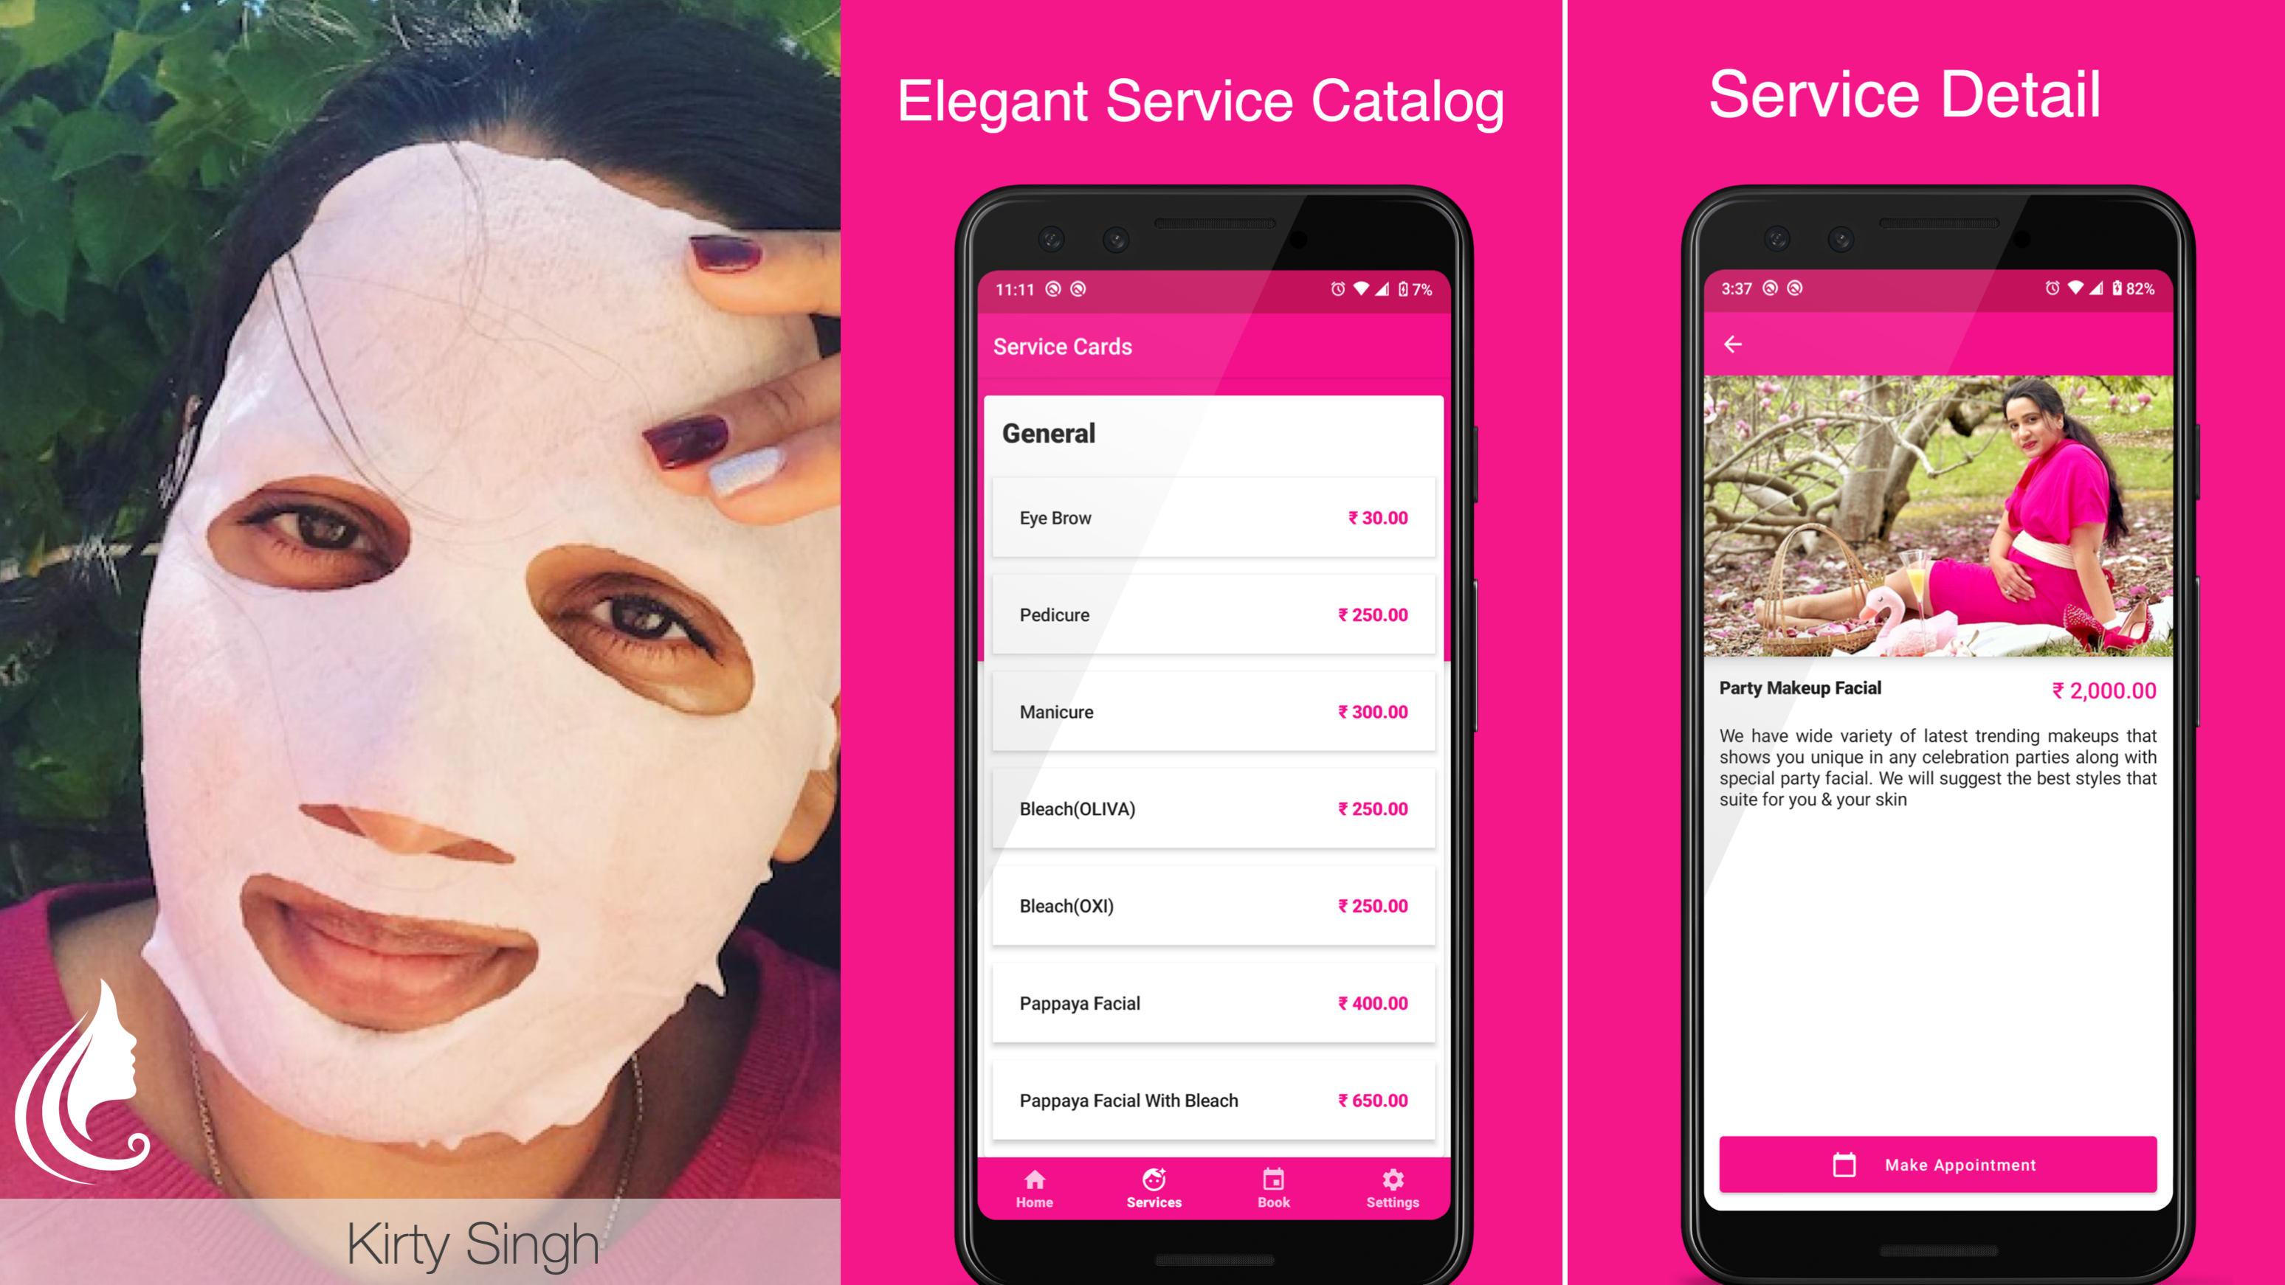
Manage Services

Slide 9
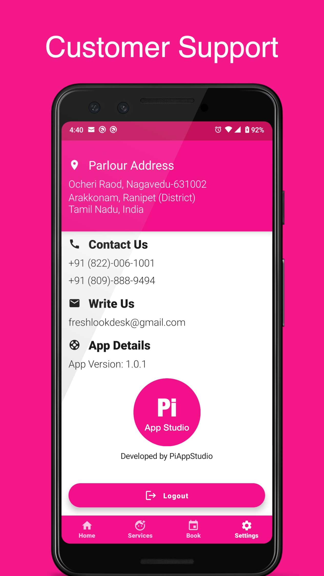
Settings

Slide 10
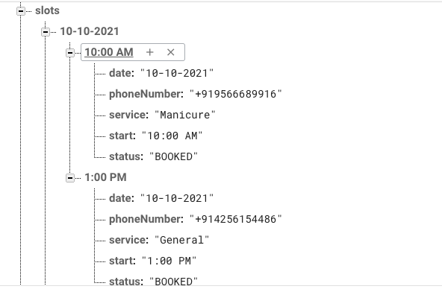
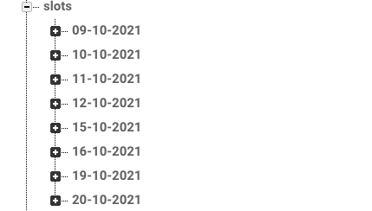
Slots database

Slide 11
Basic feature’s Pricing Plan!!!
Description | Little Boy | Fat Man
1 Month FREE trail | Yes | Yes
1 Month FREE training & Support | Yes | Yes
Can terminate, if you NOT interested after trail period? | Yes | Yes
Source code accessibility | NO | Yes
Google AdSense | MUST | Optional
Google AdSense revenue | We Owns all the amounts | You Owns all the amount
Prices | FREE | Rs. 3,00,000 (Excluding GST+ other google service charges)
Additional features | Pay on demand | Pay on demand

Slide 12
Thank you! Questions Please?

